Slide 1
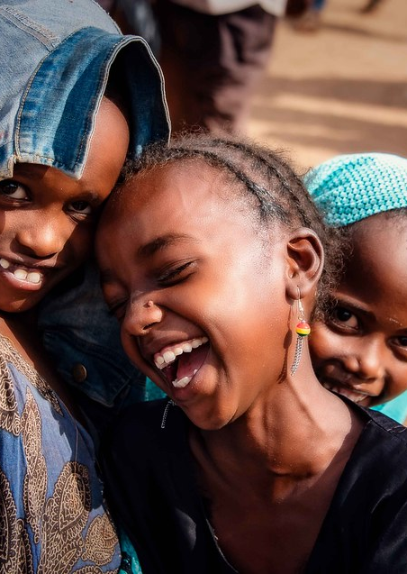
Research on Kenya’s ICT Education: The case of Moringa School
Team: Workshop 4 Group 5
Team Members:
Aiqiao Li, Xixiang Chen, Zichen Pang, Shiyun Zhu, Bowen Zhang
This Photo by Unknown Author is licensed under CC BY-SA-NC

Slide 2
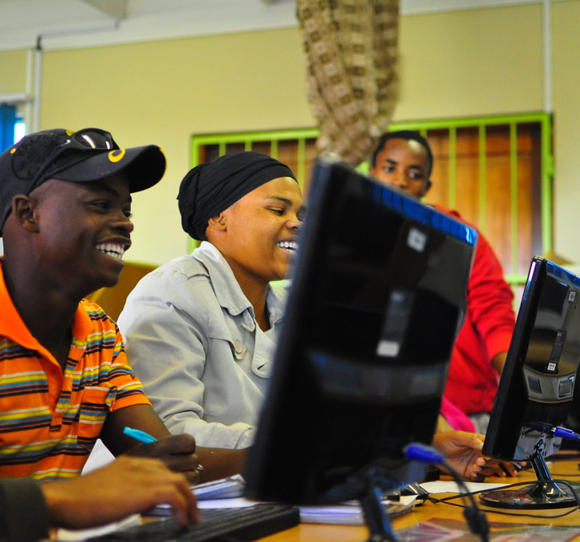
Background
People living in poor country of Kenya need more professional and advanced technical guidance to help them in ICT field, because students with poor education and techniques will lead to unemployment and low economic growth. The ICT education there need improvements and has huge potentials.
This Photo by Unknown Author is licensed under CC BY-SA

Slide 3
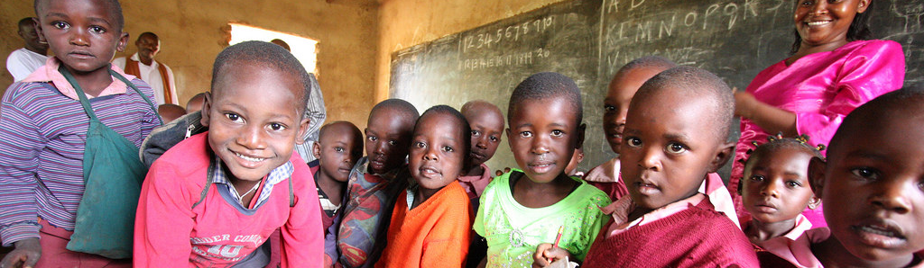
Challenge
This Photo by Unknown Author is licensed under CC BY
After screening and analyzing the current problems of ICT filed in Kenya, we found out that the ICT education faces financial, society and legal challenges. The students and local society need more and better ICT education. We will try our best to acquire macro, industry and personal data and analyze the local successful third-party education institution’s business and operation model.

Slide 4
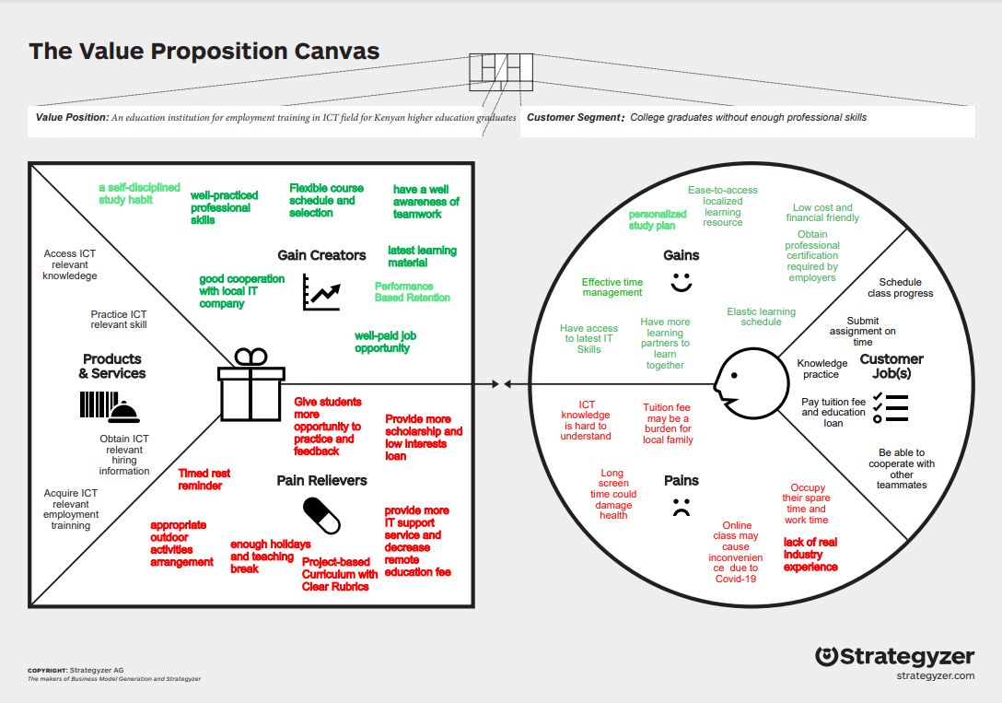
Problem
The unemployment rate in Kenya for 20-24years old is very high obviously, which means the young Kenya graduates do not have enough employability in the labor market. The evidence is that it is as 14.2% according to Kenya official survey, However, the ICT market is expanding fast, which means there is high potential for both Kenya’s ICT market and the young graduates.
We have noticed that the cyber security may be a potential increasing point, since the mobile transaction users is also rising in recent years but the cyber-attack in Kenya has increased by 106.7% from 2020 to 2021.

